Slide 1
Advanced Basic Education Program
Ch7. What is the Convolution Neural Network (CNN) - 02. Model
Notes:
안녕하세요 오늘 발표를 맡은 이준원입니다. 잘 부탁드립니다.
오늘 빌표 주제는 CNN기반의 model에 대해 설명드리겠습니다.

Slide 2
02. model
1. Review
2. Overview
3. LeNet, AlexNet
4. VGGNet, GoogLeNet

Slide 3
02. model
1. Review

Slide 4

Review
Single Channel Convolution
When input size m x m, filter size n x n, stride =s, output size = (m-n)/(s+1) x (m-n)/(s+1)
first source pixel
1 | 0 | 1 | 1 | 0
1 | 0 | 0 | 1 | 0
0 | 1 | 1 | 1 | 1
0 | 1 | 0 | 1 | 1
0 | 0 | 0 | 1 | 1
1 | 1 | 0
1 | 0 | 1
1 | 1 | 0
3 | 4
Input image
Filter
output
(1x1) : 1x1 + 0x1 + 1x0 + 1x1 + 0x0 + 0x1 + 0x1 + 1x1 + 1x0 = 3
(1x2) : 0x1 + 1x1 + 1x0 + 0x1 + 0x0 + 1x1 + 1x1 + 1x1 + 1x0 = 4
Input 5x5, filter 3x3, stride=1

Slide 5
Review
Padding
Prevent data loss due to reduced output size after convolution
Add a specific value of pixels to the outside of the input to make the output size equal to or similar to the input size
0 | 0 | 0 | 0 | 0
0 | 1 | 1 | 0 | 0
0 | 0 | 0 | 1 | 0
0 | 0 | 1 | 1 | 0
0 | 0 | 0 | 0 | 0
1 | 1 | 0
0 | 0 | 1
0 | 1 | 1
Input image
zero padding

Slide 6
Review
Pooling(Subsampling)
To reduce the input to a small size output by extracting only representative features
In inference, there is no need to have all the information of the image
Reduce parameter-> overfitting ↓, computation ↓, faster
20
25
12 | 20
3 | 9
25 | 2
8 | 1
94
34
Max pooling
34 | 71
77 | 94
34 | 7
22 | 5
11
9
69
17
Activation map
Average pooling

Slide 7
02. Model
2. Overview

Slide 8





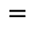

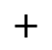

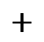
Multi Channel Convolution
One Filter
Stride = 1
Padding = 0
Two Filter
Stride = 1
Padding = 0
8 | 3 | 5 | 7 | 9
3 | 1 | 5 | 3 | 1
6 | 8 | 7 | 4 | 2
5 | 1 | 9 | 3 | 6
3 | 7 | 2 | 8 | 1
8 | 3 | 5 | 7 | 9
3 | 1 | 5 | 3 | 1
6 | 8 | 7 | 4 | 2
5 | 1 | 9 | 3 | 6
3 | 7 | 2 | 8 | 1
1 | -1
1 | -1
7 | 1 | 5 | 4 | 2
8 | 1 | 5 | 3 | 1
6 | 8 | 7 | 4 | 2
5 | 1 | 9 | 3 | 6
3 | 7 | 2 | 8 | 1
1 | -1
1 | -1
7 | 1 | 5 | 4 | 2
8 | 1 | 5 | 3 | 1
6 | 8 | 7 | 4 | 2
5 | 1 | 9 | 3 | 6
3 | 7 | 2 | 8 | 1
$$⋆$$
1 | -1
1 | -1
4 | 2 | 5 | 7 | 9
5 | 1 | 5 | 3 | 1
6 | 8 | 7 | 4 | 2
5 | 1 | 9 | 3 | 6
3 | 7 | 2 | 8 | 1
$$⋆$$
1 | -1
1 | -1
4 | 2 | 5 | 7 | 9
8 | 1 | 5 | 3 | 1
6 | 8 | 7 | 4 | 2
5 | 1 | 9 | 3 | 6
3 | 7 | 2 | 8 | 1
1 | -1
1 | -1
1 | -1
1 | -1
2 x 2 x 3
2 x 2 x 3
1 | -1
1 | -1
$$⋆$$
1 | -1
1 | -1
1 | 0
0 | -1
5 x 5 x 3
5 x 5 x 3
$$=$$
2 x 2 x 3
$$=$$
‼️ Number of input channels = Number of filter channels ‼️
 |  |  | 2
6
6
$$=$$
$$⋆$$
$$+$$
$$⋆$$
$$+$$
$$⋆$$
4 x 4 x 1
4 x 4 x 2

Slide 9

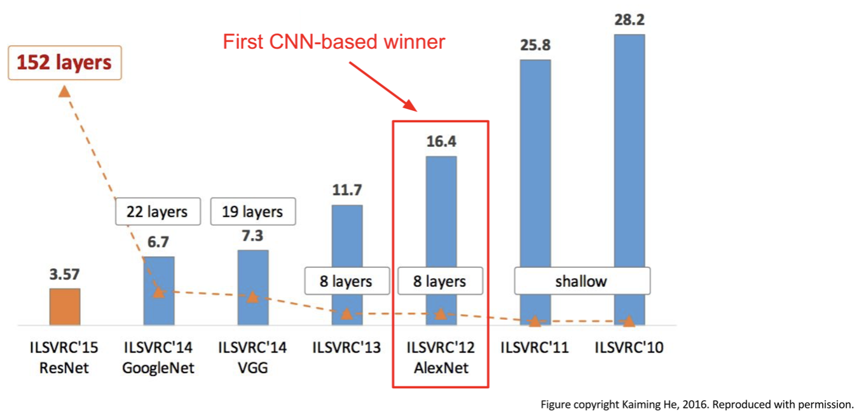
What is ILSVRC?
ILSVRC(ImageNet Large Scale Visual Recognition Challenge)
Image recognition and image classification have the same meaning.
The ILSVRC is a competition that gives a large set of images and evaluates the performance of image classification algorithms.
The algorithms that won the ILSVRC contest have played a major role in the development of computer vision.
Machine Learning (ML)
Artificial Intelligence
Machine Learning
CS231n

Slide 10
Famous CNN Architecture Models
LeNet
LeNet-5 is a CNN model from Yann LeCun's 1998 paper, Gradient-Based Learning Applied to Document Recognition.
CNN model proposed by Yann LeCun for more efficient recognition than the hand-designed feature extractor & fully-connected multi-layer networks method.
AlexNet
Alexnet is a model structure that has led to CNN's widespread application in the field of computer vision and was developed by Krizhevsky and Hinton.
Alexnet won the 2012 ILSVRC competition with a big performance difference. (10% error rate)

Slide 11
Famous CNN Architecture Models
VGGNet
The VGGNet was developed by Kaern simonyan and Andrew zisserman at the University of Oxford in the United Kingdom and finished second in the 2014 ILS VRC competition.
VGGNet showed how depth of layer affects accuracy in recognizing large volumes of images.
GoogLeNet
GoogLeNet was developed by Google's Szegedy and won first place in the 2014 ILSVRC competition.
GoogLeNet introduces the concept of Inception module to significantly reduce the number of parameters in the network (AlexNet 60m >>> GoogLeNet 4m)

Slide 12
02. Model
3. LeNet, AlexNet

Slide 13
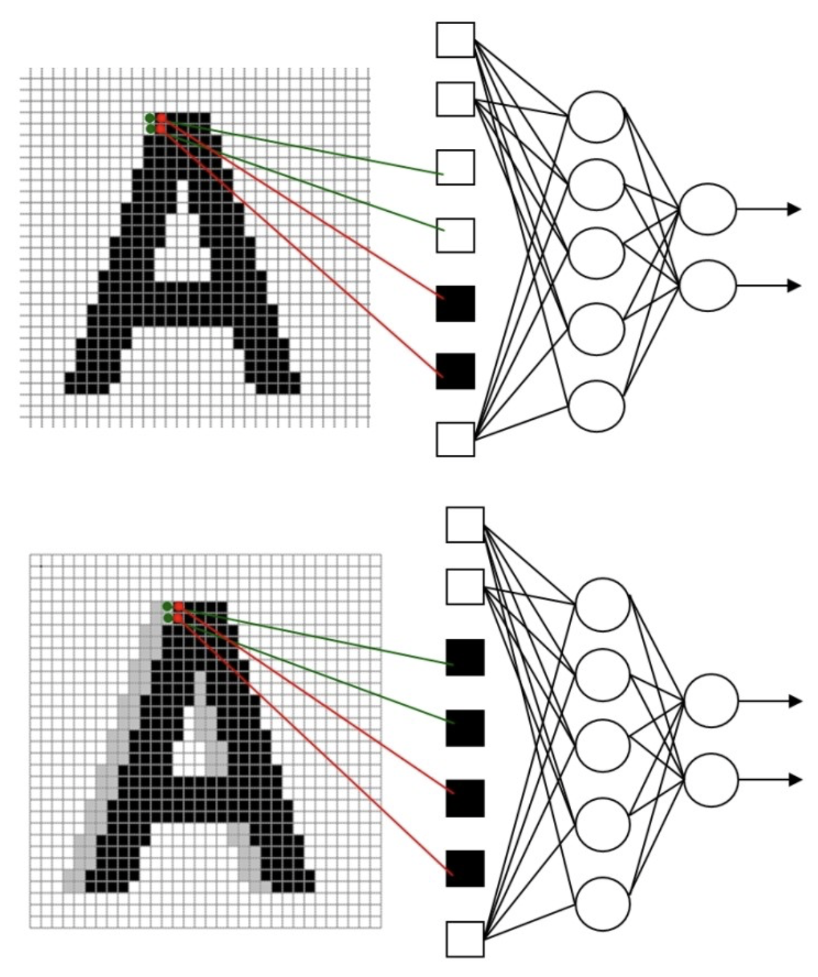
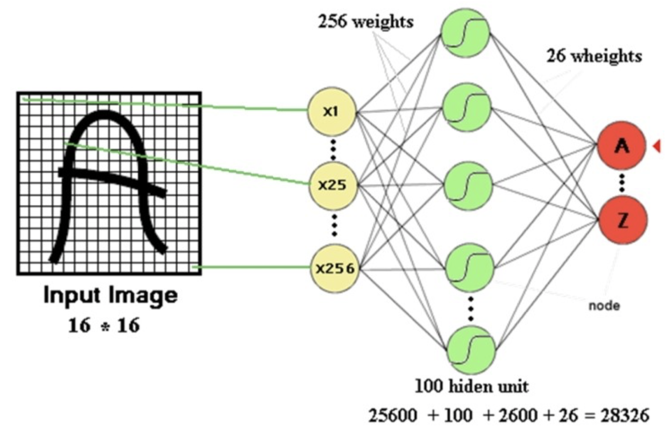
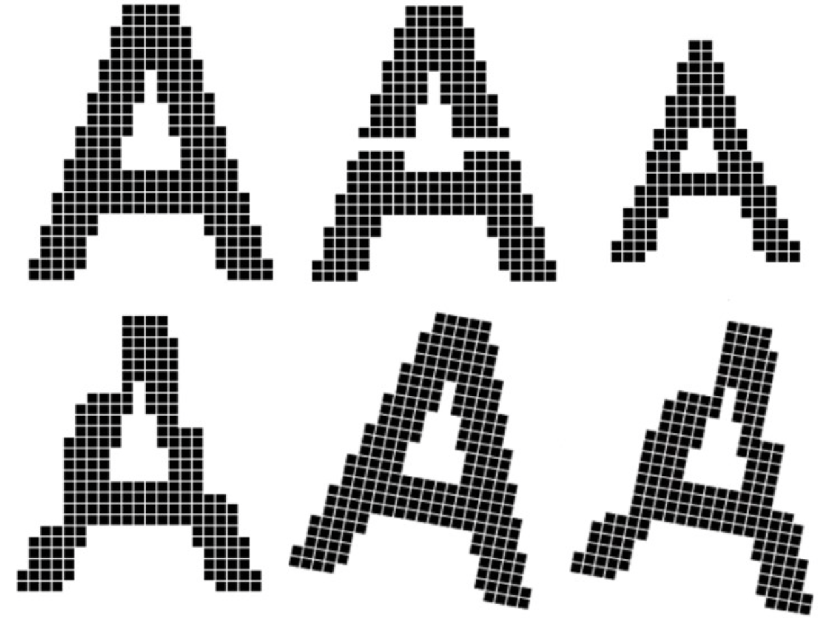
LeNet
The problems of traditional methods
The Hand-designed feature extractor extracts only limited features.
Contains too many parameters.
The topology of the input is completely ignored.
Notes:
https://m.blog.naver.com/laonple/221193389981

Slide 14
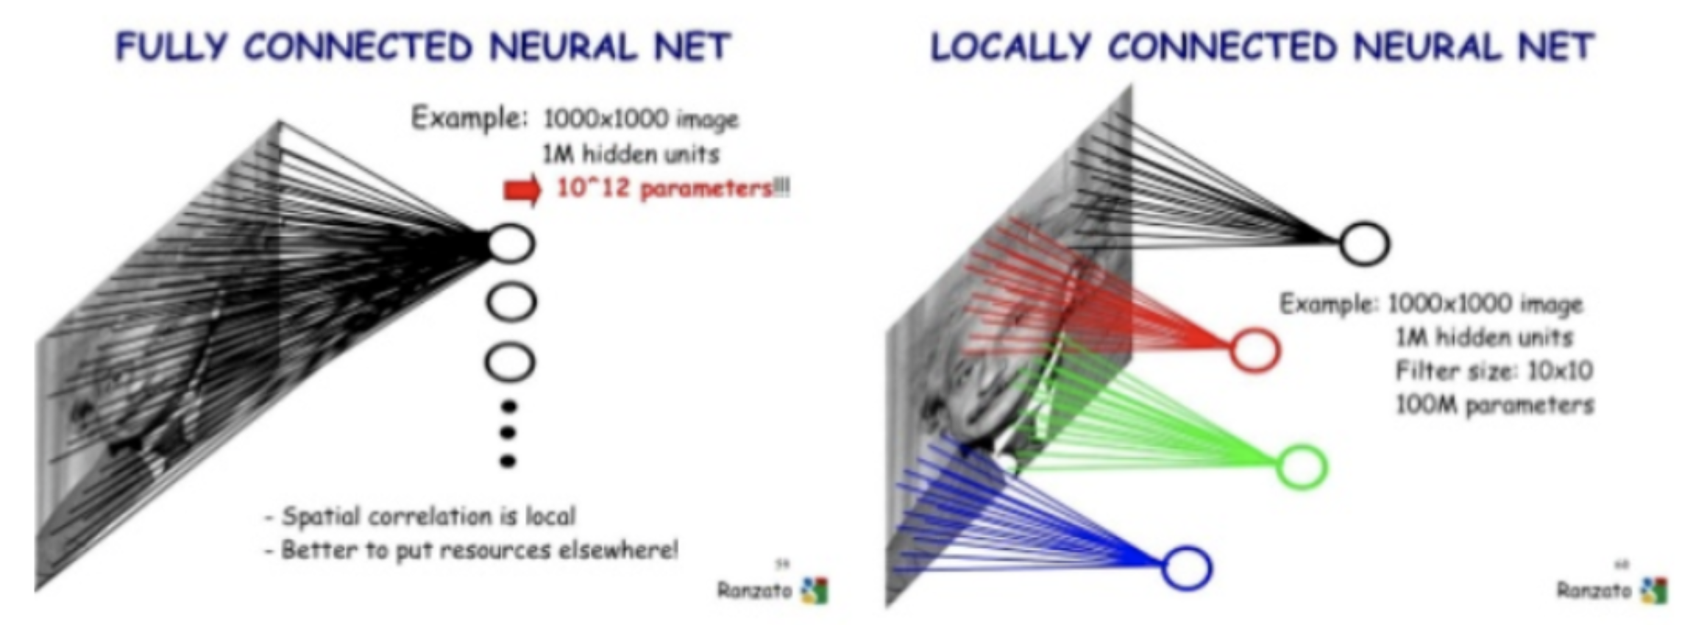
LeNet
Three ideas
Local receptive fields
Shared weights
Subsampling
Notes:
https://arxiv.org/pdf/1706.09077.pdf
http://www.bioinfo.org.cn/∼casp/temp/DeepLearning.pdf

Slide 15
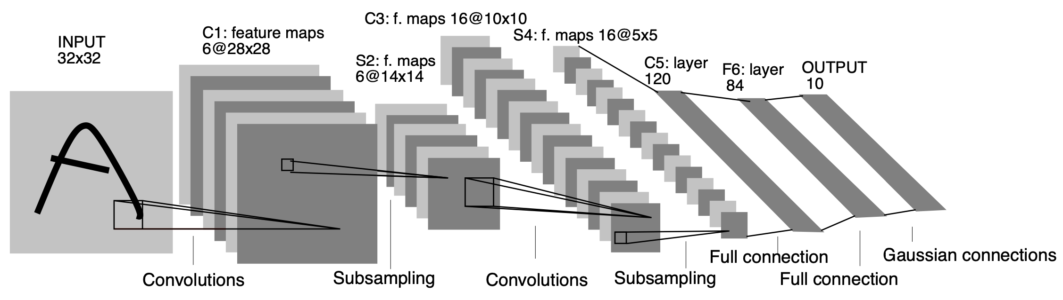
LeNet
LeNet Architecture
The structure of the LeNet-5 consists of [Conv(C1)-Subsampling(S2) - Conv(C3) - Subsampling(S4) - Conv(C5) - FC – FC]

Slide 16
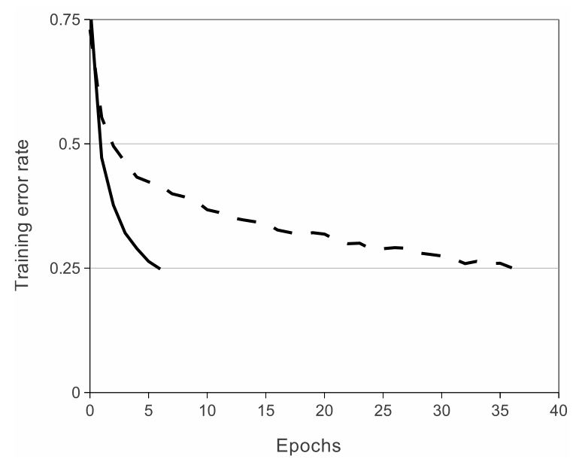
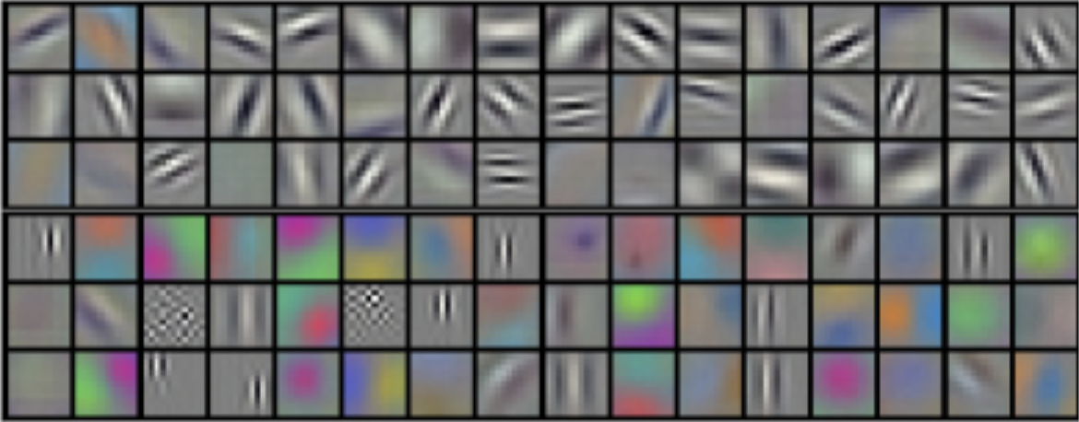
AlexNet
Four ideas
ReLU Nonlinearity
Training on Multiple GPUs
Local Response Normalization(LRN)
Overlapping Pooling
12 | 20
3 | 9
25 | 2
8 | 1
34 | 71
77 | 94
34 | 7
22 | 5

Slide 17
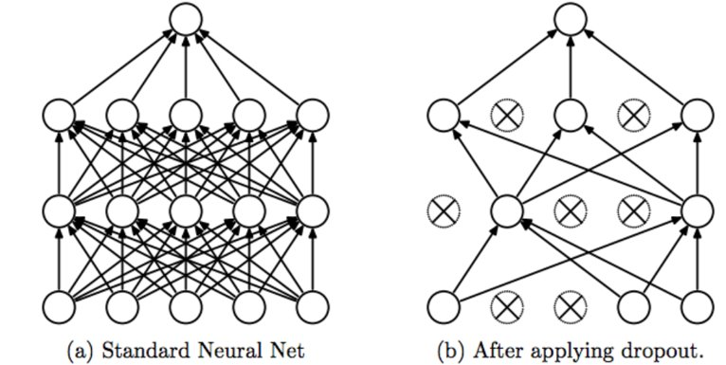

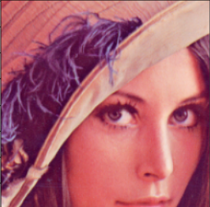
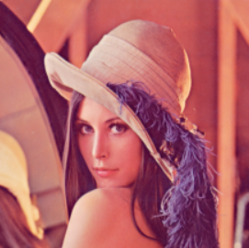
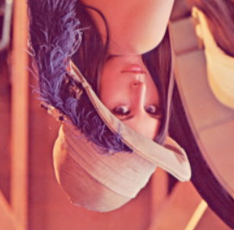
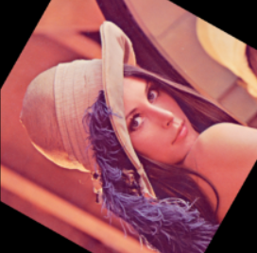
AlexNet
Reducing Overfitting
Data Augmentation
Dropout

Slide 18
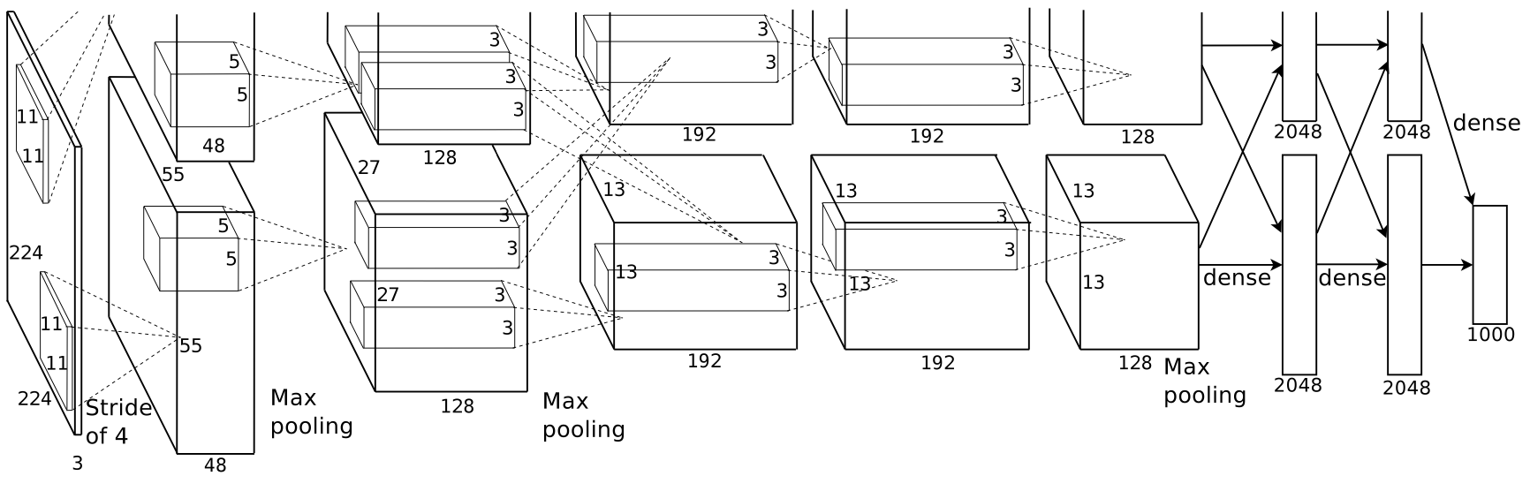
AlexNet
AlexNet Architecture
The structure of the AlexNet consists of [Conv(C1) - MaxPool(M2) - Norm(N3) - Conv(C4) - MaxPool(M5) - Norm(N6) - Conv(C7) - Conv(C8) - Conv(C9) - MaxPool(M10) - FC – FC - FC]

Slide 19
02. Model
4. VGGNet, GoogLeNet

Slide 20
VGGNet
Why use only 3x3 convoultion?
Decrease parameters.
As the number of layers increases, the non-linearity increases further.
it is good to extract useful features.
Speed up learning.
5 x 5 x C ; S = 1
3 x 3 x C ; S = 1
3 x 3 x C ; S = 1
7 x 7 x C
3 x 3 x C
7 x 7 x C
5 x 5 x C
3 x 3 x C
# Params = 25 x c x c >>> # Params = 9 x c x c + 9 x c x c

Slide 21
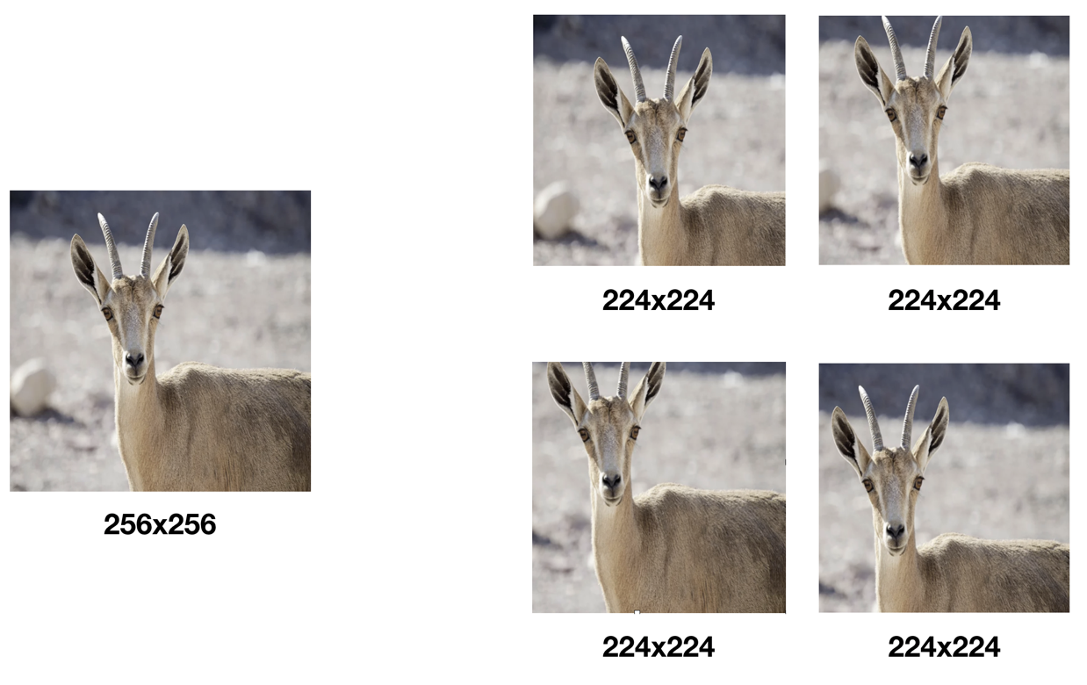
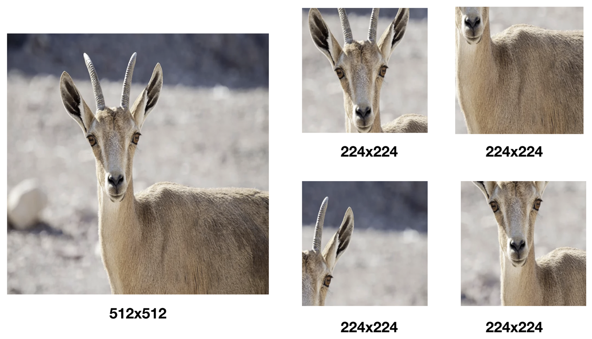
VGGNet
Training?
pre-initialization
data augmentation
Randomly flip cropped images horizontally
To change the RGB value randomly
image rescaling

Slide 22
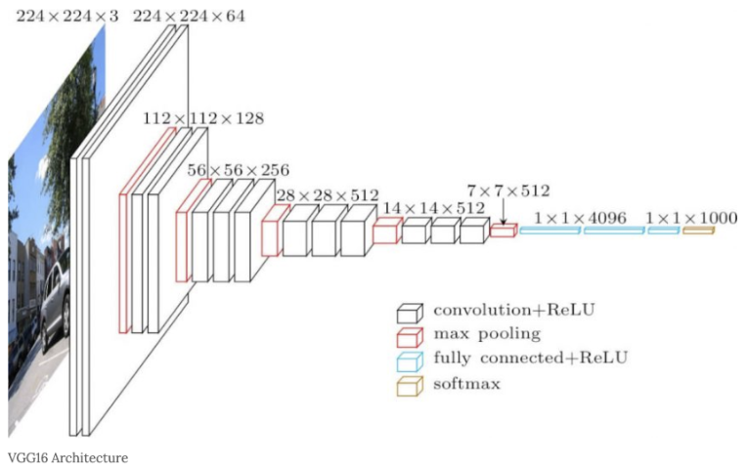
VGGNet
VGGNet Architecture
The structure of the VGGNet consists of [Conv(C1) - Conv(C2) - MaxPool(M3) - Conv(C4) - Conv(C5) - MaxPool(M6) - Conv(C7) - Conv(C8) - Conv(C9) - MaxPool(M10) - Conv(C11) - Conv(C12) - Conv(C13) - MaxPool(M14) - FC – FC - FC]

Slide 23
GoogLeNet
What is the 1 x 1?
Reduced computation
Dimension reduction
an increase in nonlinearity
Overfitting prevention
5 x 5 x 64
5 x 5 x 64
1 x 1 x 32
28 x 28 x 128
28 x 28 x 64
28 x 28 x 128
28 x 28 x 32
28 x 28 x 64
# Params = 4 >>> # Params = 1

Slide 24
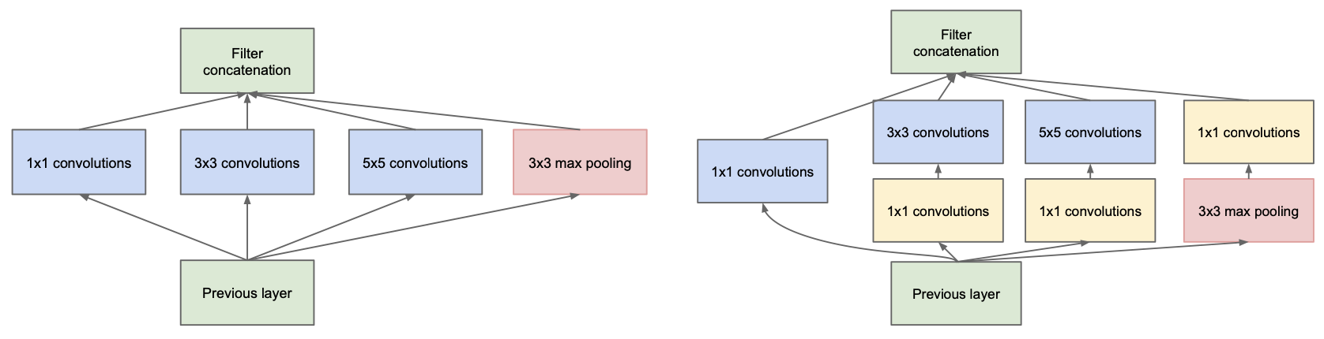
GoogLeNet
What is the Inception module?
Various filters
Decrease the number of dimensions
Deep network is possible

Slide 25
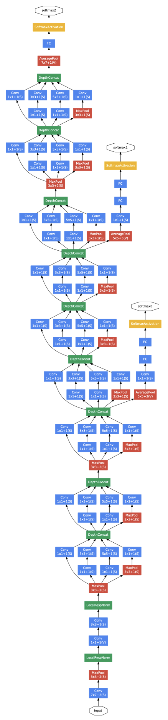
GoogLeNet
GoogLeNet Architecture
The structure of the GoogLeNet consists of [Conv(C1) - MaxPool(M2) – Conv(C3) – Conv(C4) - MaxPool(M5) – Inception(In6) x 2 - Inception(In7) x 2 - MaxPool(M8) - Inception(In9) x 2 - Inception(In10) x 2 - Inception(In11) x 2 - Inception(In12) x 2 - Inception(In13) x 2 - MaxPool(M14) - Inception(In15) x 2 - Inception(In16) x 2 – AvgPool(A17) - FC
Notes:
AVP 설명
Auxiliary classifier 설명

Slide 26
Code Practice
Model Implementation

Slide 27
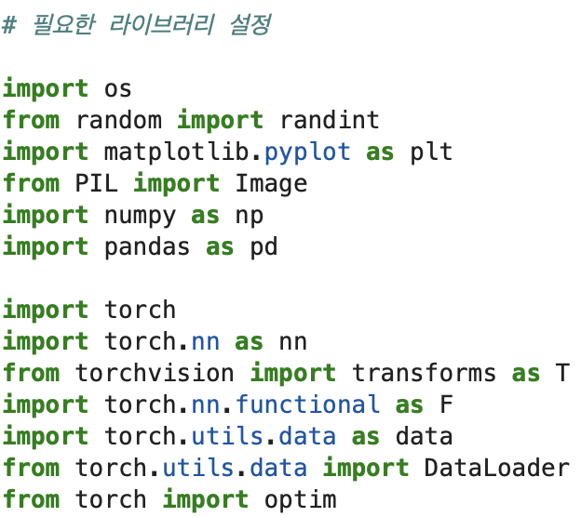
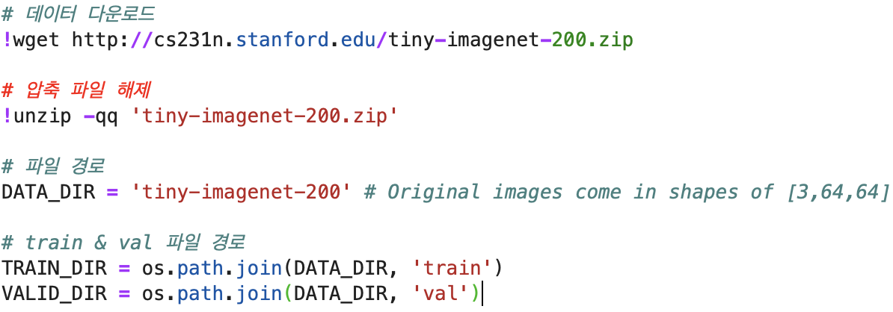
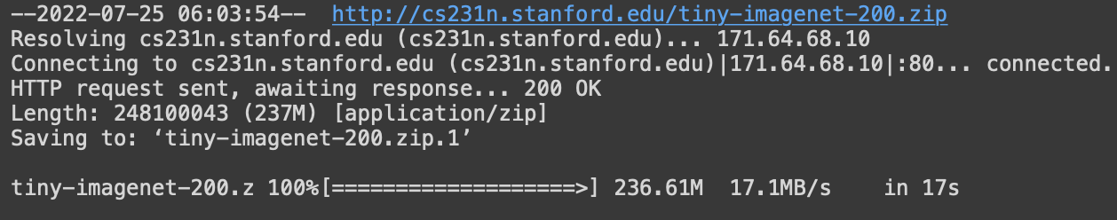
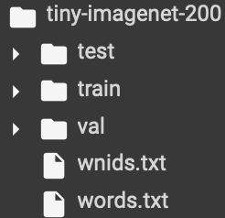
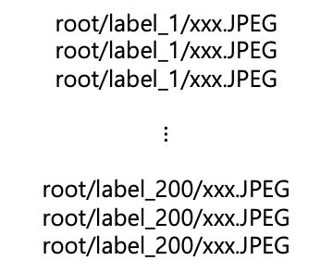
PyTorch Tutorial
Data download
root/label_1/xxx.JPEG
root/label_1/xxx.JPEG
root/label_1/xxx.JPEG
$$⋮$$
root/label_200/xxx.JPEG
root/label_200/xxx.JPEG
root/label_200/xxx.JPEG

Slide 28
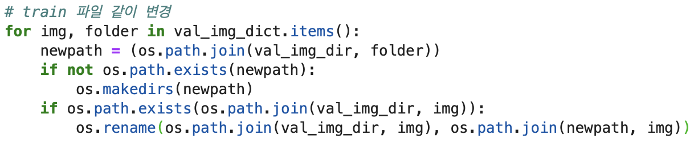
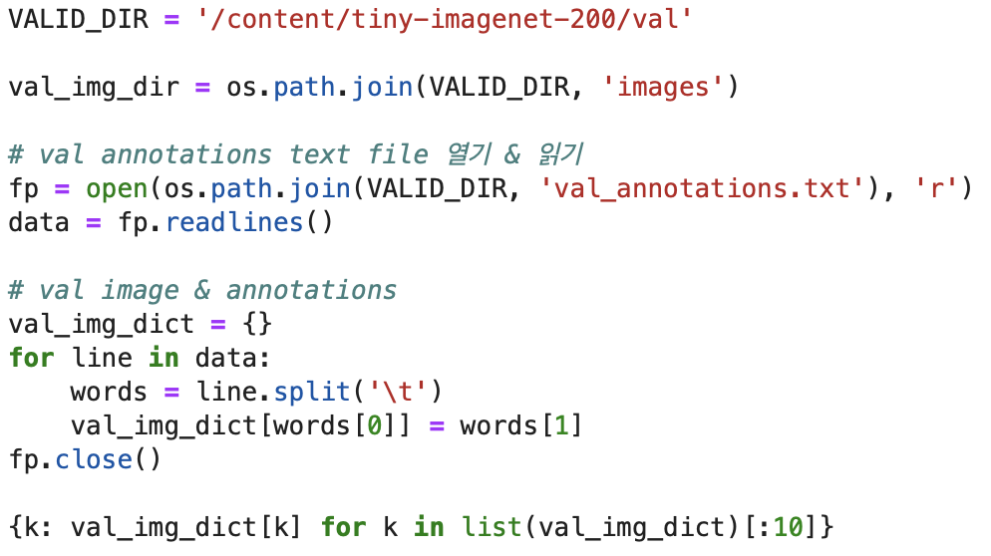
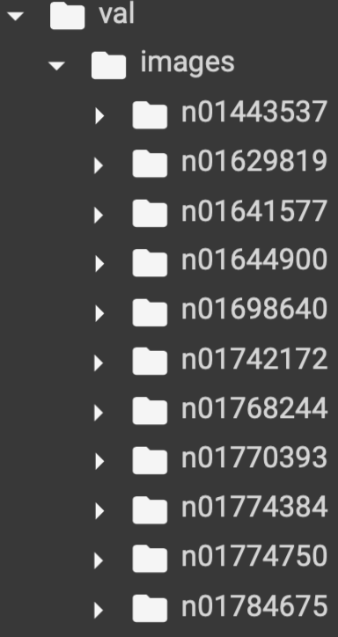
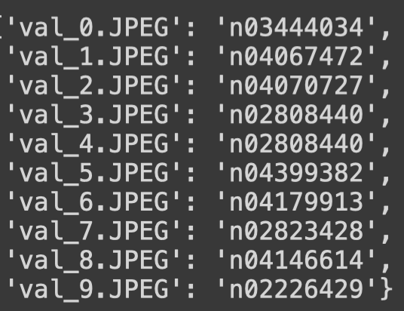
PyTorch Tutorial
Pre-process

Slide 29
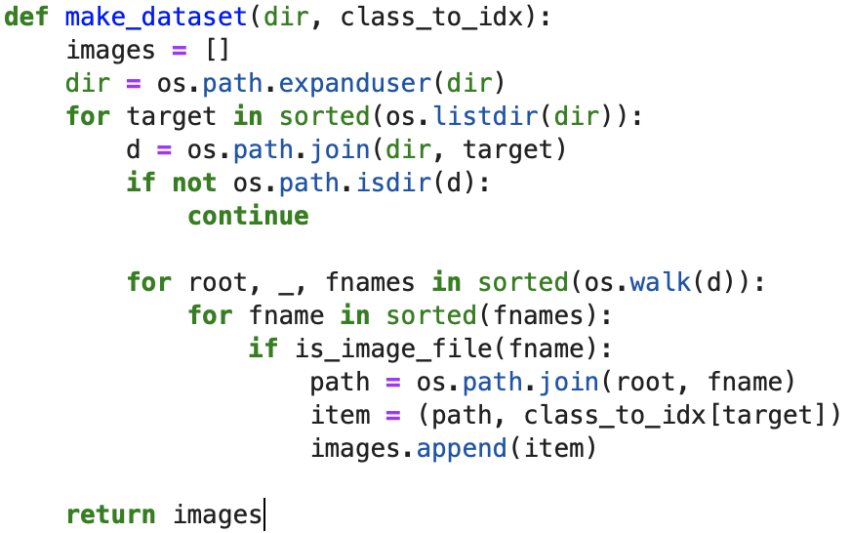
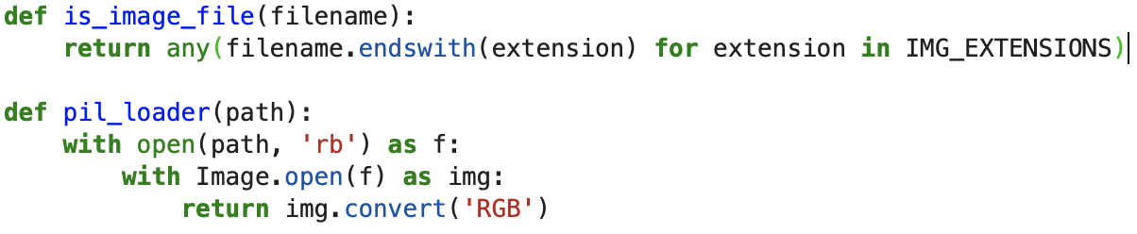
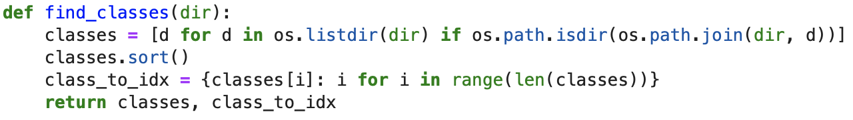
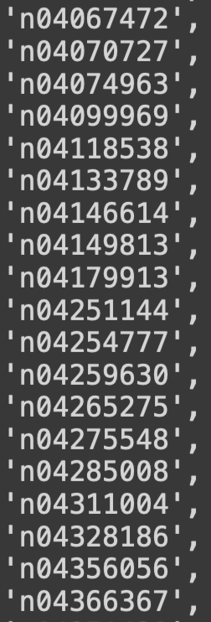
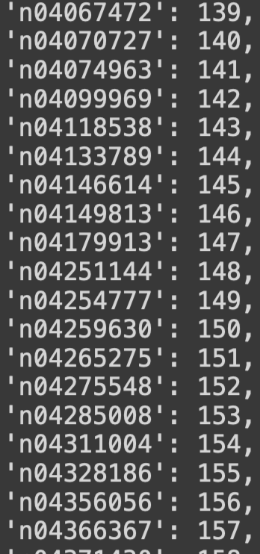
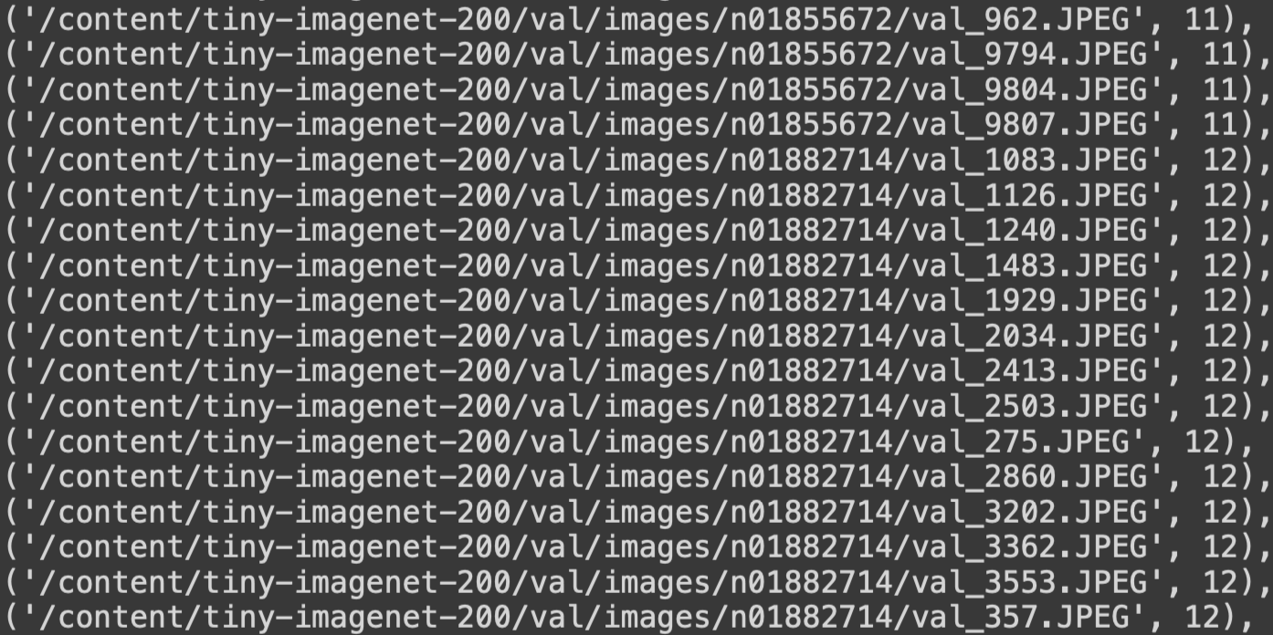
PyTorch Tutorial
Pre-process

Slide 30
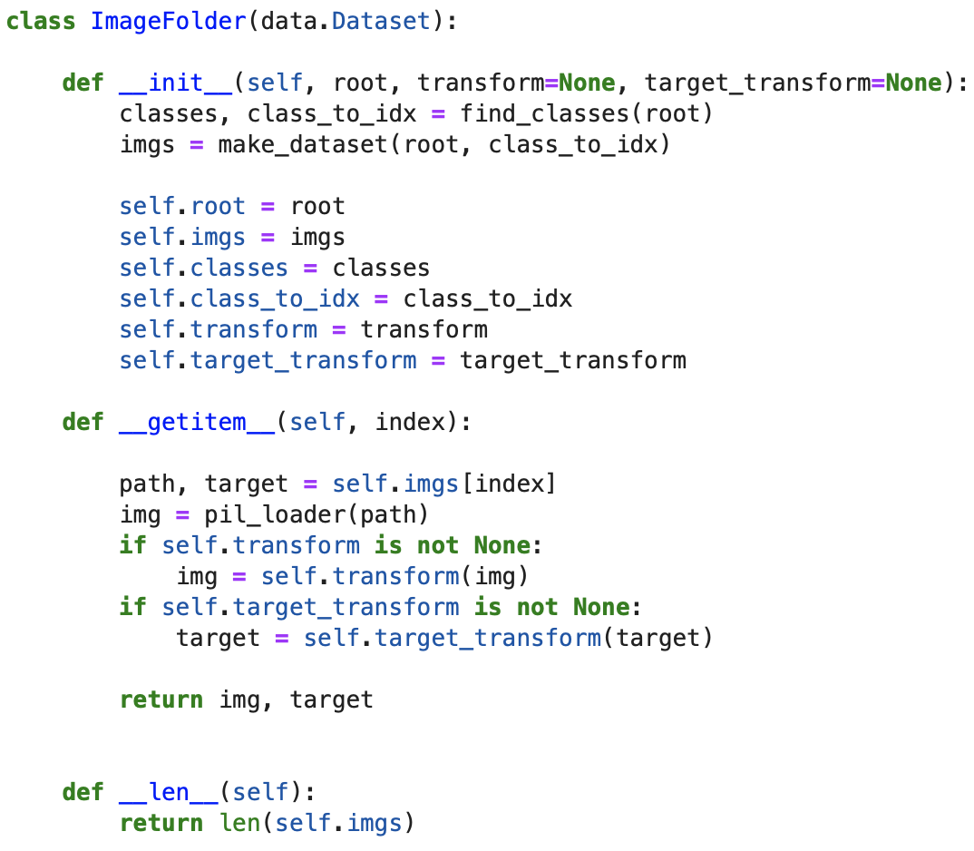
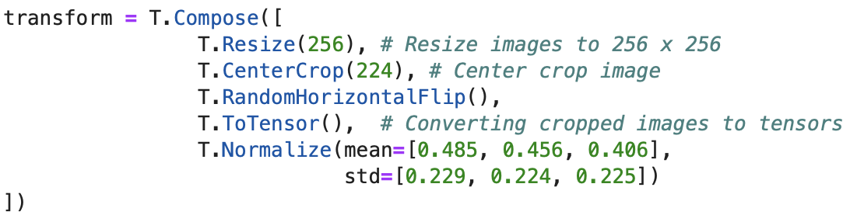
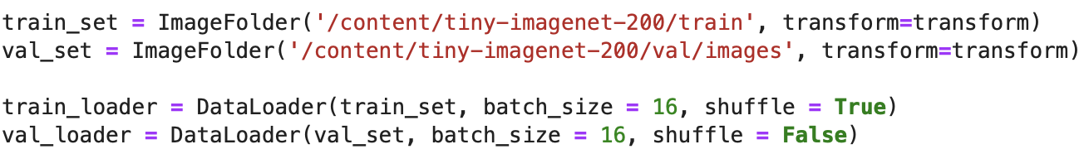
PyTorch Tutorial
Pre-process & DataLoader

Slide 31
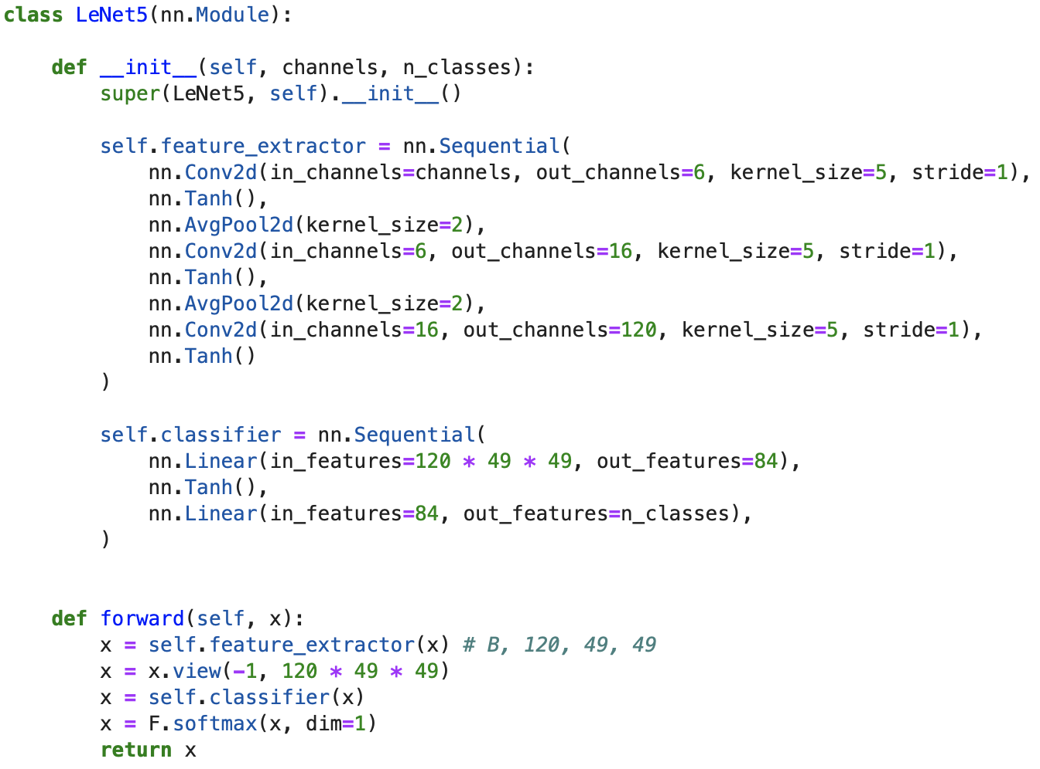
PyTorch Tutorial
Model(LeNet)
[Conv(C1)-Subsampling(S2) - Conv(C3) - Subsampling(S4) - Conv(C5) - FC – FC]

Slide 32
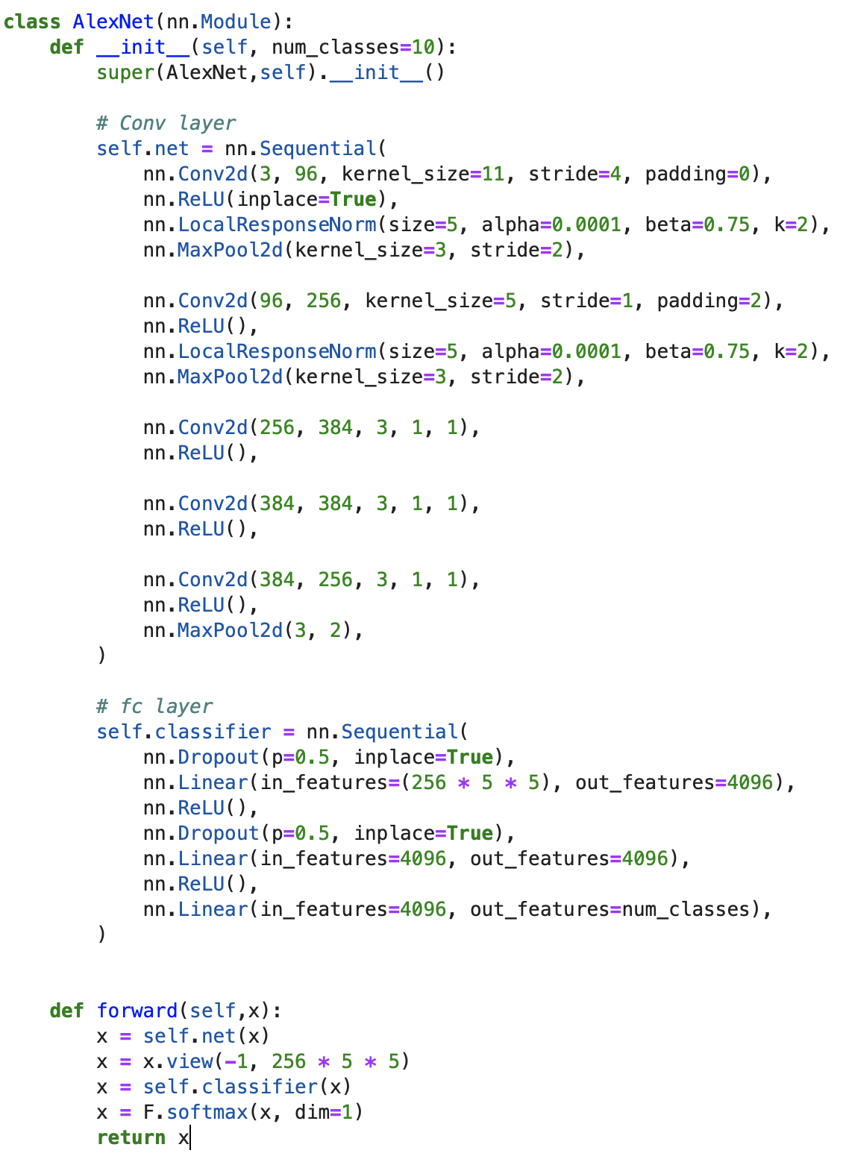
PyTorch Tutorial
Model(AlexNet)
[Conv(C1) - MaxPool(M2) - Norm(N3) - Conv(C4) - MaxPool(M5) - Norm(N6) – Conv(C7) - Conv(C8) - Conv(C9) - MaxPool(M10) - FC – FC - FC]

Slide 33
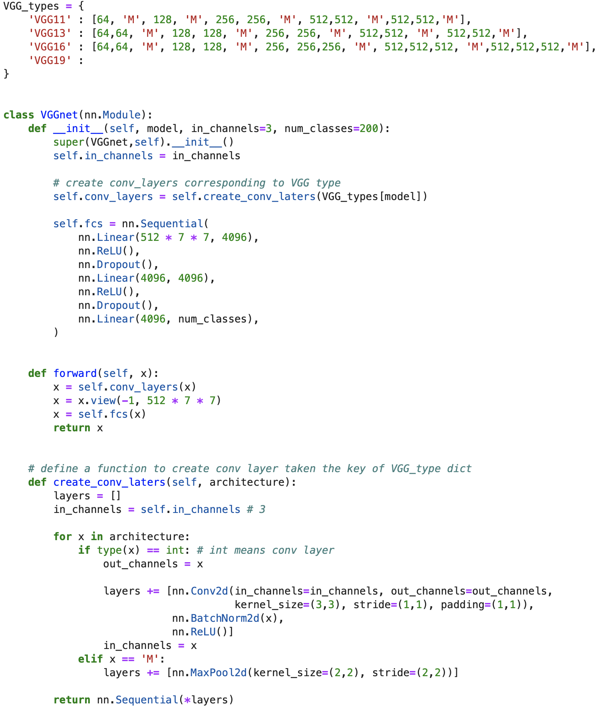
PyTorch Tutorial
Model(VGGNet)
?
[Conv(C1) - Conv(C2) - MaxPool(M3) - Conv(C4) - Conv(C5) - MaxPool(M6) - Conv(C7) - Conv(C8) - Conv(C9) - MaxPool(M10) - Conv(C11) - Conv(C12) - Conv(C13) - MaxPool(M14) - FC – FC - FC]

Slide 34
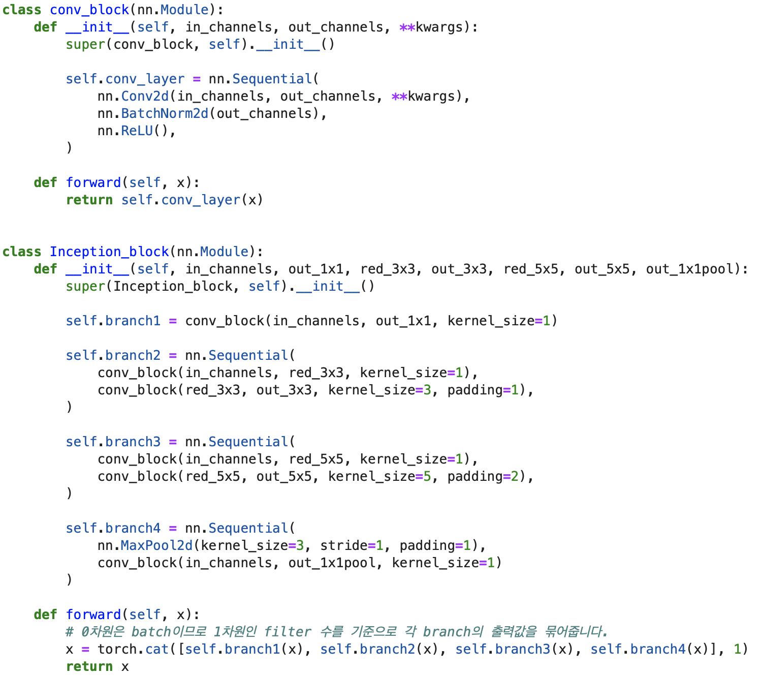
PyTorch Tutorial
Model(Inception)

Slide 35
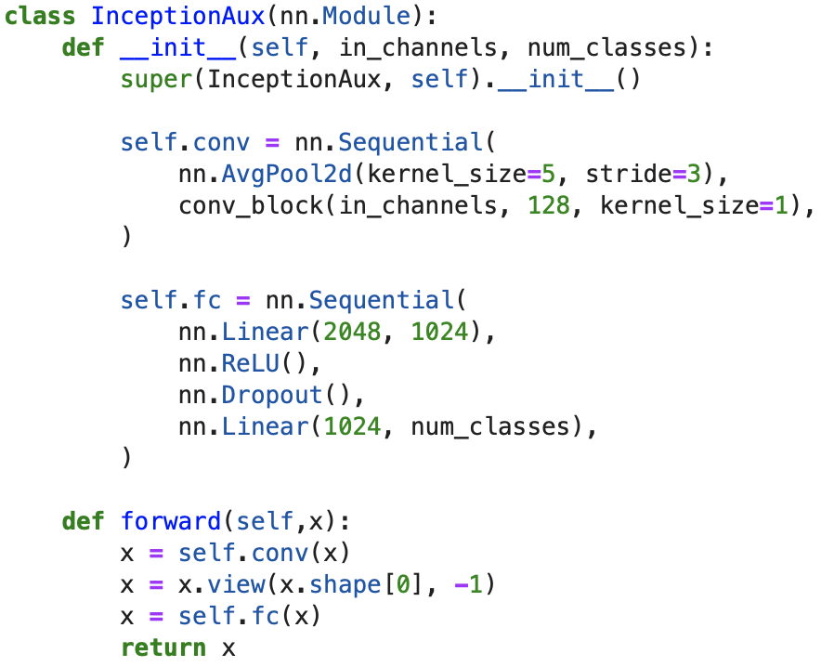
PyTorch Tutorial
Model(InceptionAux)

Slide 36
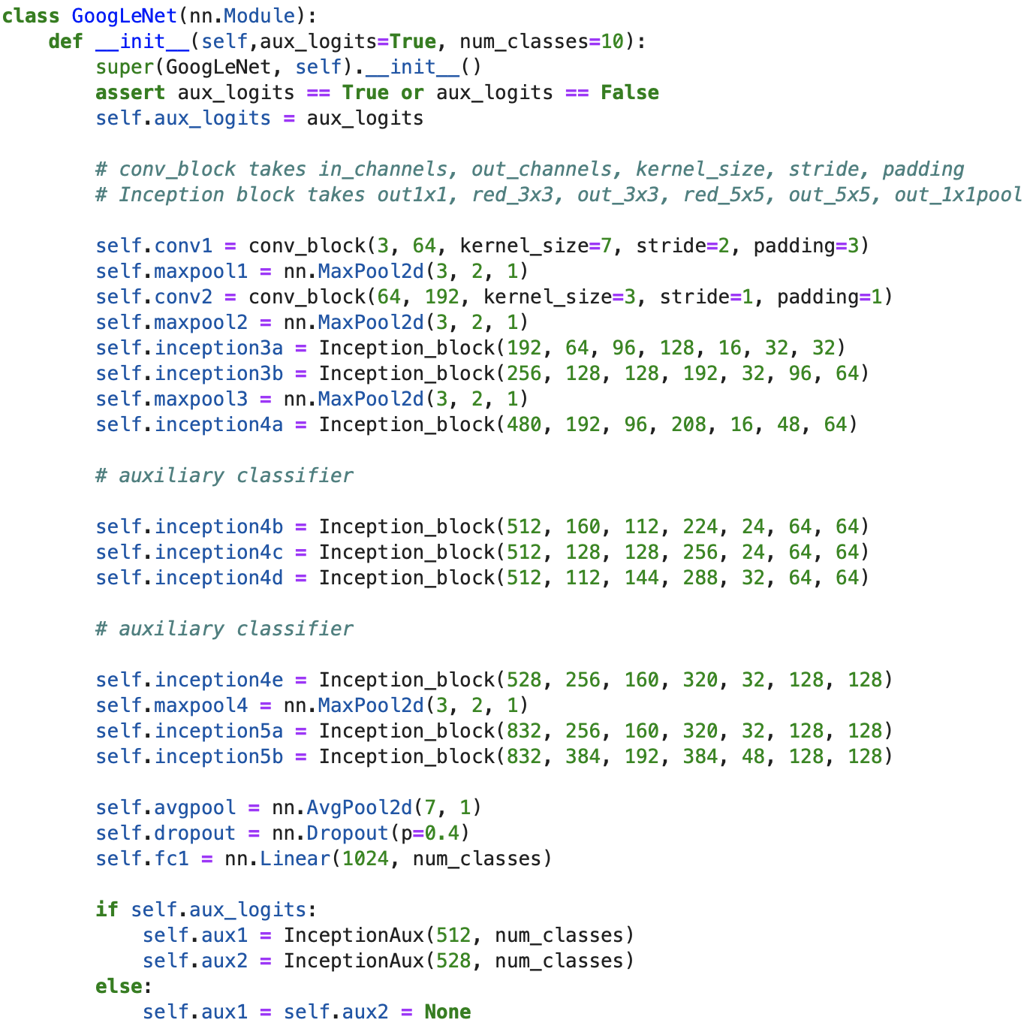
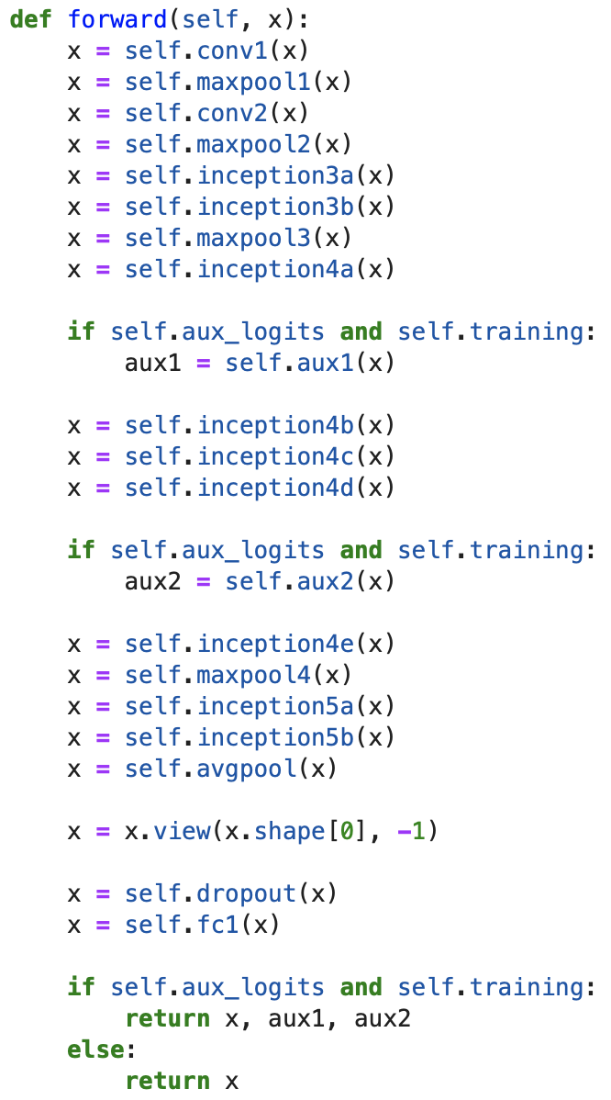
PyTorch Tutorial
Model(GoogLeNet)
[Conv(C1) - MaxPool(M2) – Conv(C3) – Conv(C4) - MaxPool(M5) – Inception(In6) x 2 - Inception(In7) x 2 - MaxPool(M8) - Inception(In9) x 2 - Inception(In10) x 2 - Inception(In11) x 2 - Inception(In12) x 2 - Inception(In13) x 2 - MaxPool(M14) - Inception(In15) x 2 - Inception(In16) x 2 – AvgPool(A17) - FC

Slide 37
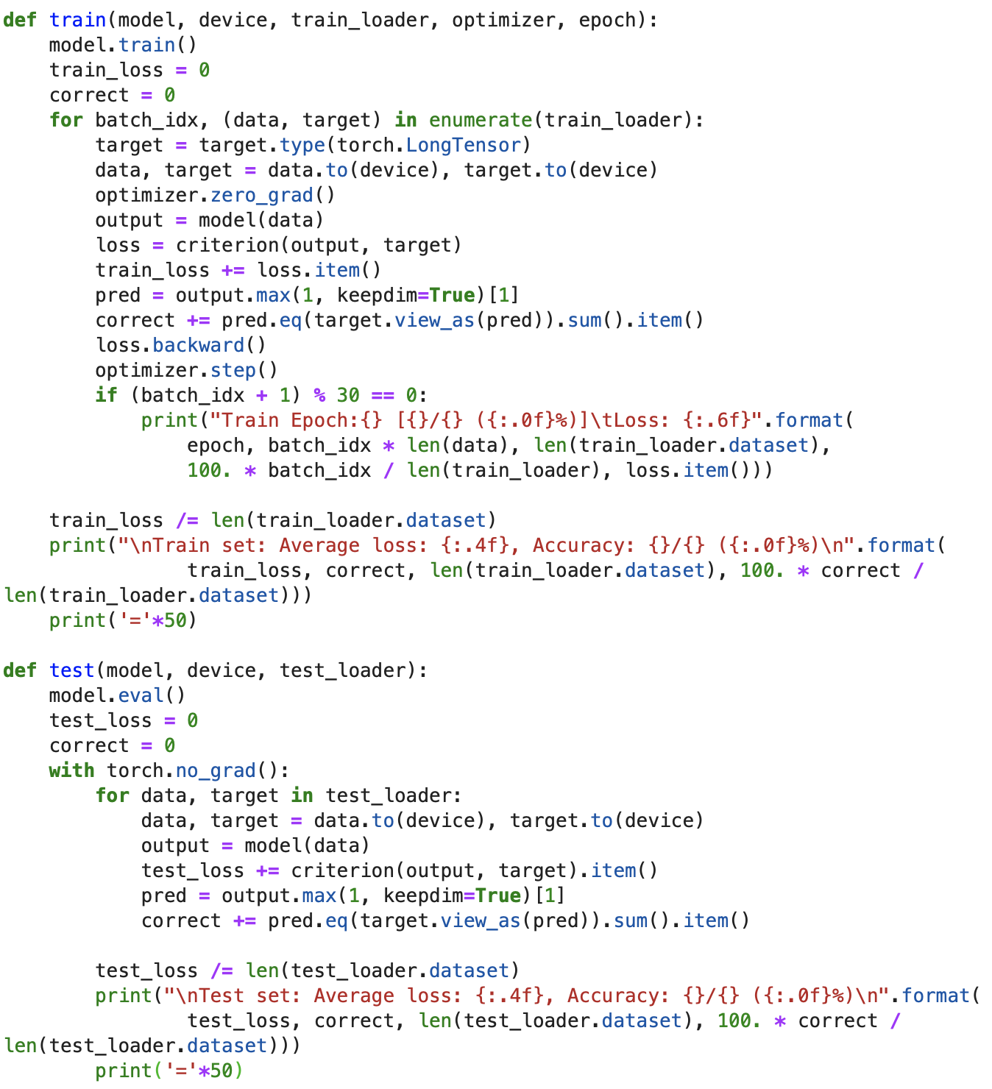
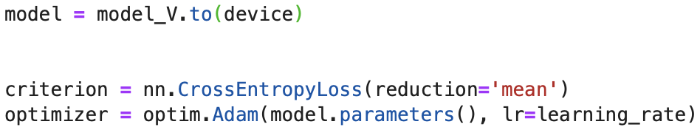
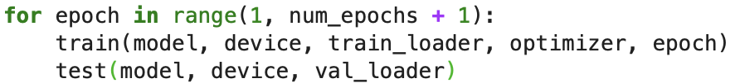

PyTorch Tutorial
Model_L : LeNet
Model_A : AlexNet
Model_V : VGGNet
Model_G :GoogLeNet
Model(Train & Val)

Slide 38

We have Assignment
Assignment #1
Assignment #2
Implement VGGNet-19
Learning a Model
Data
Tiny ImageNet
Choose 1 out of 3 models
AlexNet, VGGNet, GoogLeNet
Train & Val & Test
Write as a report
Dataset
Model
Results
Code

Slide 39


We have Assignment
Assignment #3
Download "Dog and Cat (https://www.kaggle.com/c/dogs-vs-cats)" data
Upload to Google Drive

